Slide 1
RSS Statistical Ambassador Showcase
Statistics for All
Anthony B. Masters
Statistical Ambassador
9th September 2021

Slide 2
Helping with Statistics of the Year 2020
Helping journalists during the pandemic
Learning and sharing more about R
Posting on Medium
FAQs and The Observer articles
Covid by Numbers

Slide 3
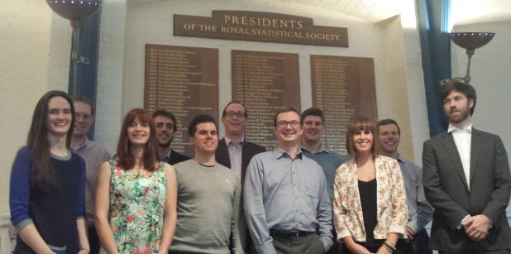
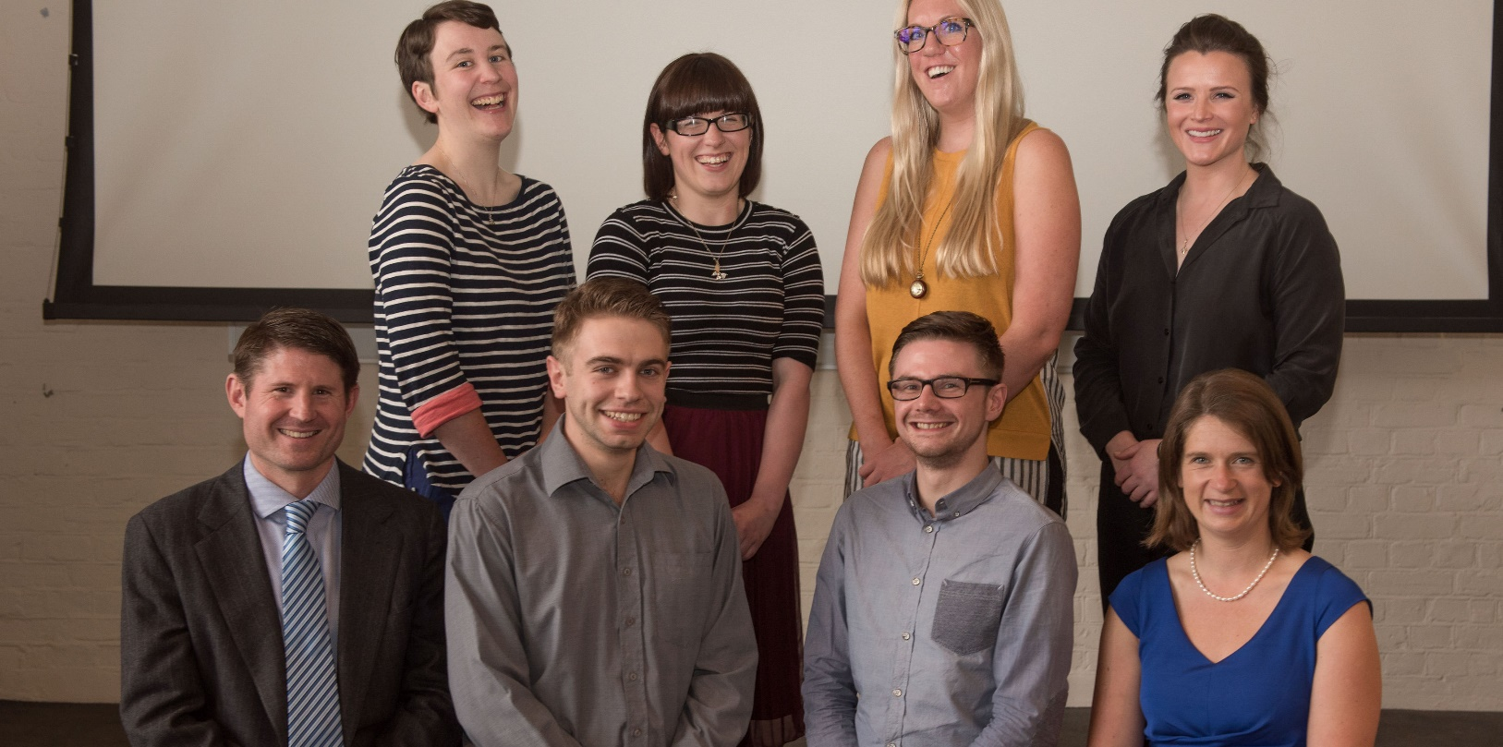
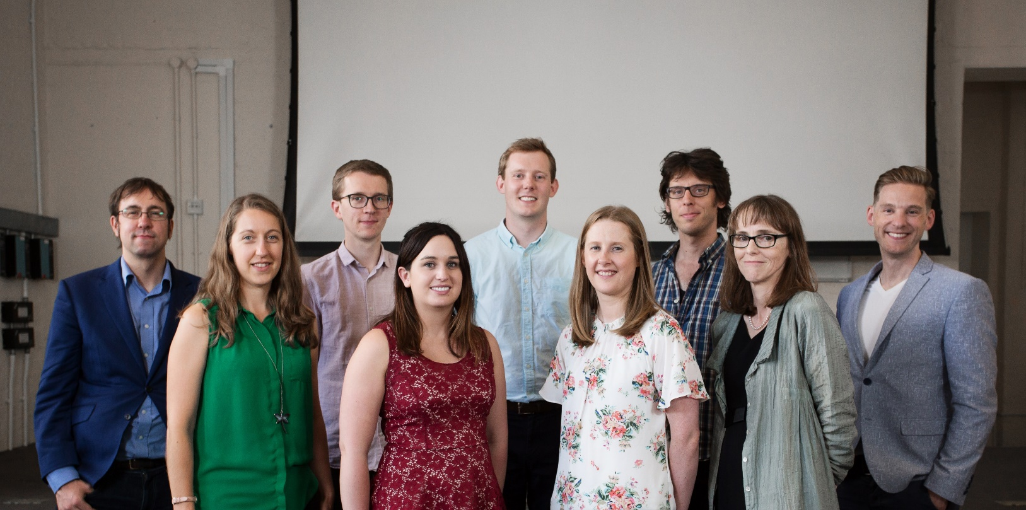
What is a Statistical Ambassador?
A Statistical Ambassador is a voluntary role for the Royal Statistical Society.
A misunderstood statistic can have dire consequences. We aim to improve public understanding of statistics. We work with policy-makers, researchers, journalists, and the public.

Slide 4
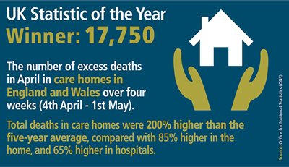
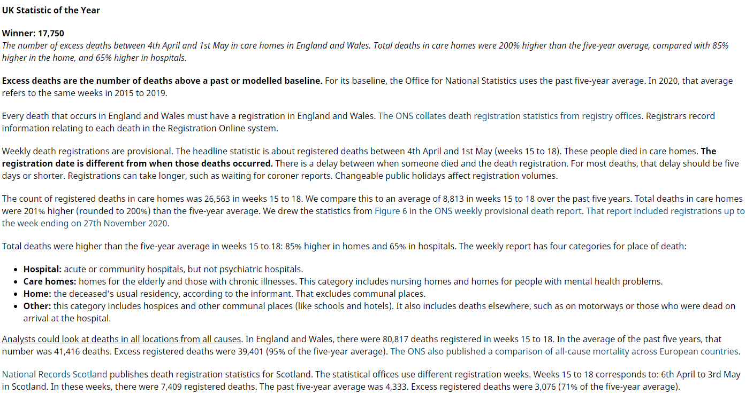
Helping with Statistics of the Year 2020
I helped with the RSS 2020 Statistics of the Year. I checked the submitted figures. As part of that work, I wrote quality and methodology information for each main entry.

Slide 5

SARS-CoV-2: the sequel worse than Highlander II
One issue has triumphed over others for statistical interest.

Slide 6



Helping journalists during the pandemic
The Covid-19 pandemic persists.
I helped journalists with statistical matters.
After the third national lockdown in England, I gave the Huffington Post a quote about case numbers.
I helped the Press Association check statistics for some unusual causes of death.
I gave an interview to the BBC World Service on counting Covid-19 deaths. I also had a discussion with a Financial Times journalist about vaccine effectiveness and coverage.

Slide 7
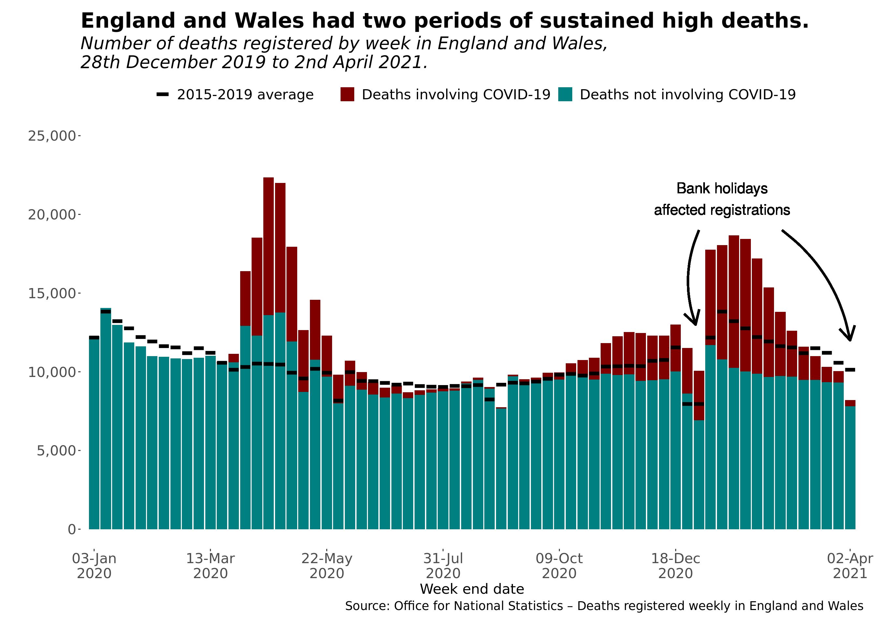
Learning and sharing more about R
I sought to improve my workflow in R. Over the past year:
Written code to draw hospital admission and occupancy statistics straight from the Public Health England API.
Emulated two different ONS graphs of death registrations.
Made repeatable tables in R.
Applied Bayesian statistics to the problem of A/B testing.
Wrangled NHS England vaccination statistics from the online file.

Slide 8
Posting on Medium
I maintain a regular Medium blog on statistical topics.
Here are some popular posts:
Title
Purpose
Deaths per Day Worldwide (17th July 2020)
A graph circulating on social media suggested there were only 56 Covid-19 deaths per day. The source is unclear and the stat appears out-of-date.
UK Polling on Black Lives Matter (15th September 2020)
A newspaper columnist asserted there were “no opinion polls available”. That was a false claim: I found UK (or GB) polls about Black Lives Matter.
Vaccine Efficacy Estimates
(28th November 2020)
News reports say that vaccines offer ‘95% protection’. The article looks at what those claims mean, and how to estimate uncertainty.
There were over 600,000 death registrations in 2020 (16th February 2021)
An erroneous image on social media claims there were only ~562,000 registrations in England and Wales. I correct that false claim.

Slide 9
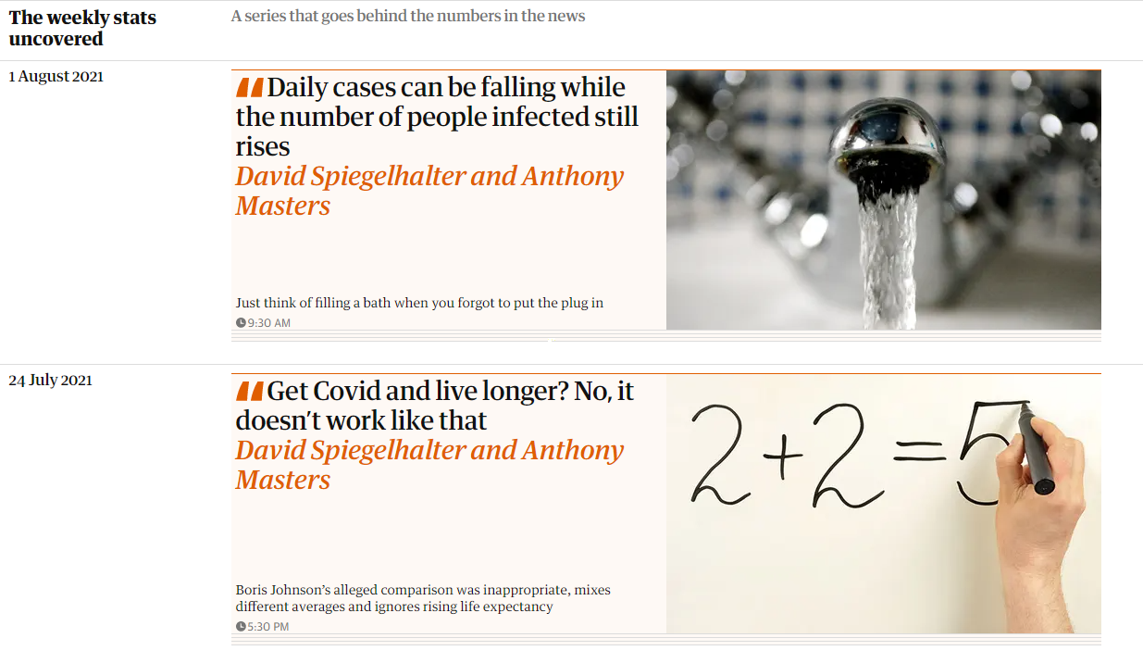
FAQs and The Observer articles
I began a fruitful collaboration with Prof Sir David Spiegelhalter.
We wrote answers to frequently-asked questions on the RSS site.
Editors at the Sunday newspapers The Observer offered Sir David a column. The rules are:
A limit of 350 words
No graphs or boxes
For the general public

Slide 10
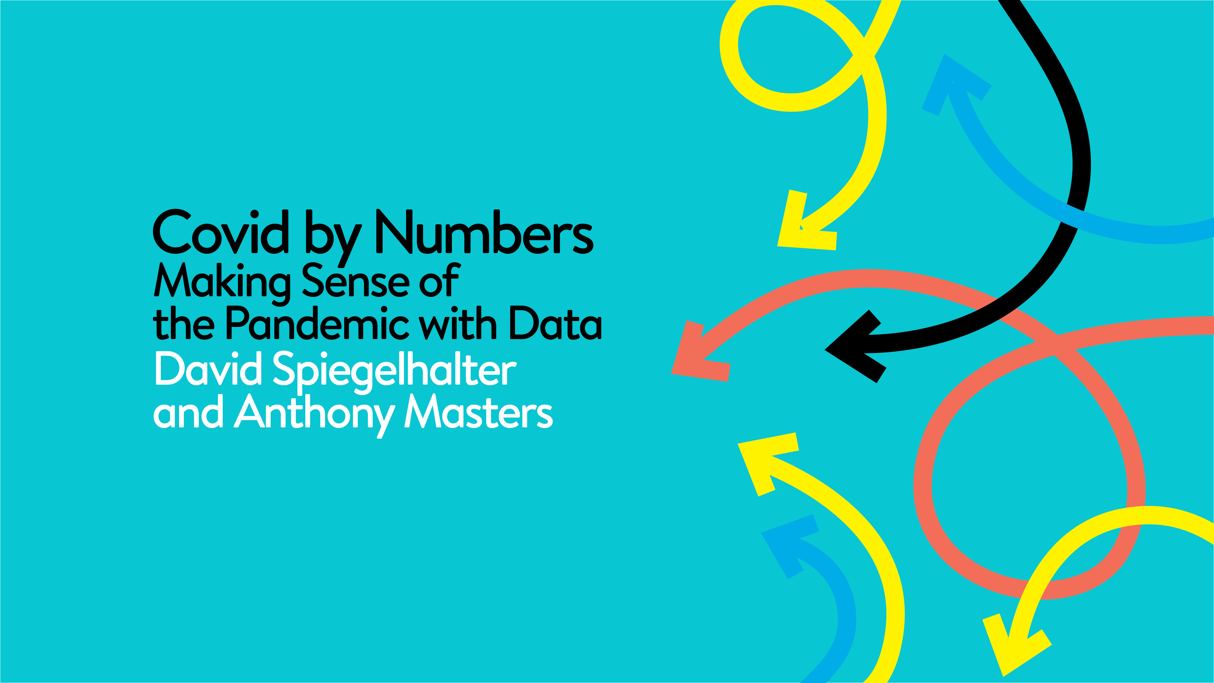

Slide 11
References
The presentation format comes from the Royal Statistical Society.
The glass SARS-CoV-2 image is credited to Luke Jerram.
The report article for 2020 Statistics of the Year 2020 is on the Royal Statistical Society website. The Covid-19 FAQs are also on the RSS site.
My quotes for The Huffington Post and Press Association are on respective sites. The BBC World Service interview is available on their website. The Financial Times article is on their website and in the print edition.
My R code is on R Pubs and GitHub. I regularly update my Medium blog.
The ‘Weekly Stats Uncovered’ articles are on The Observer website and in the Sunday print edition.
Published by Penguin Random House, ‘Covid by Numbers’ is scheduled for publication on 30th September 2021. You can pre-order now.

